Slide 1
Modern Data Engineering in the Cloud
PART 5 ADDITIONAL PDI Information

Slide 2
Table of Content
Scheduling Data Pipelines
Using a Repository
sdf

Slide 3
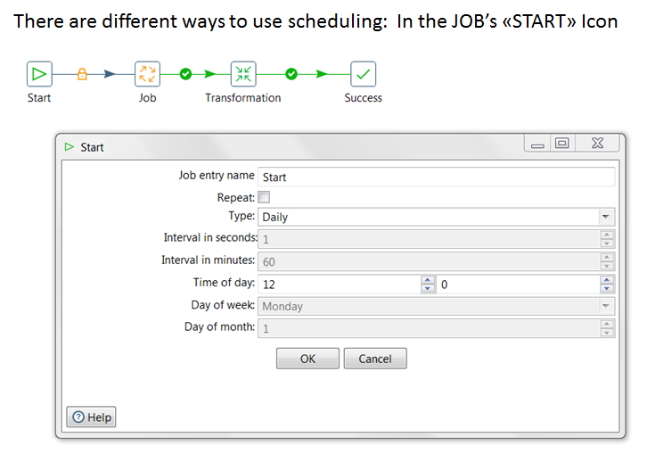
Scheduling Data Streams

Slide 4
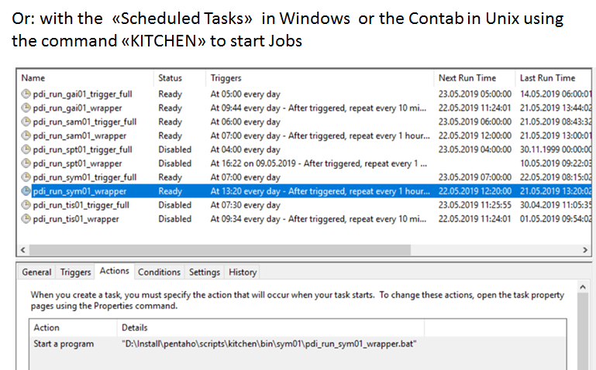
Scheduling Data Streams

Slide 5
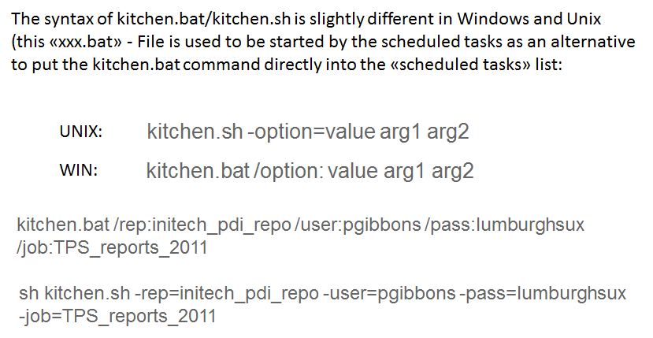
Scheduling Data Streams

Slide 6
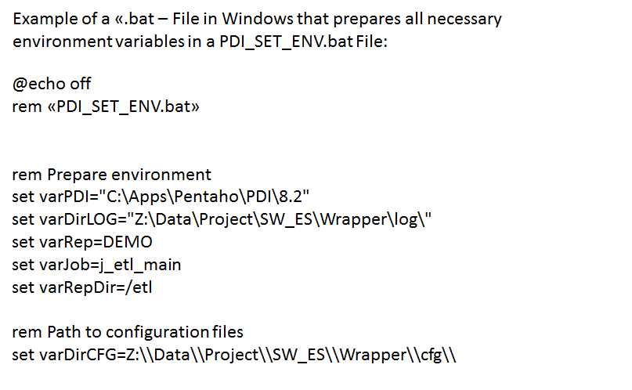
Scheduling Data Streams

Slide 7
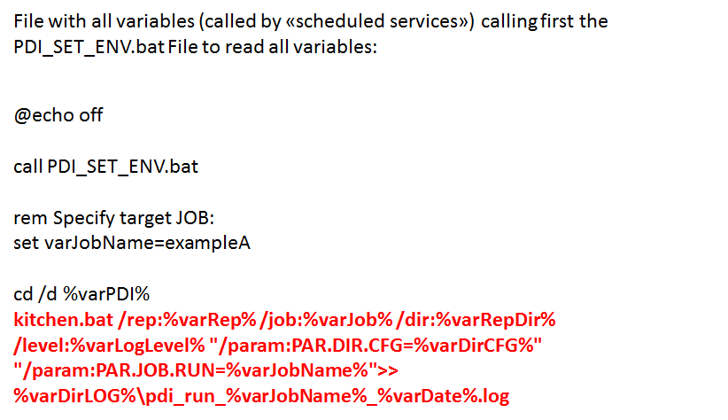
Scheduling Data Streams

Slide 8
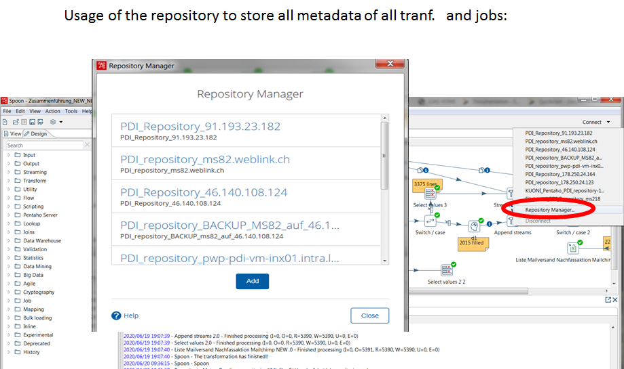
Using a repository

Slide 9
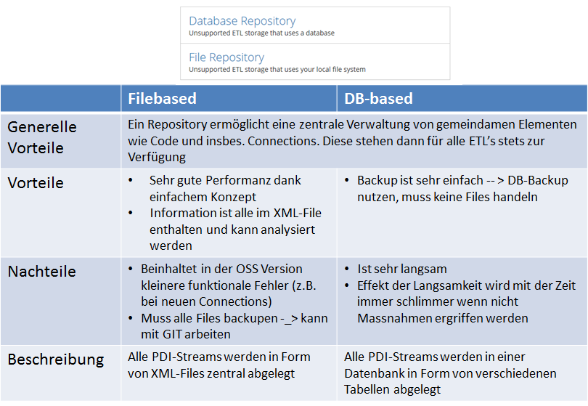
Using a repository

Slide 10
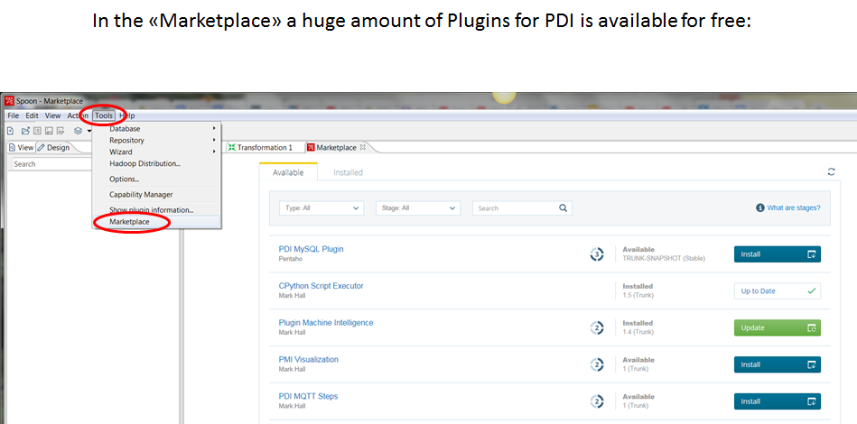
Using the “Marketplace”

Slide 11
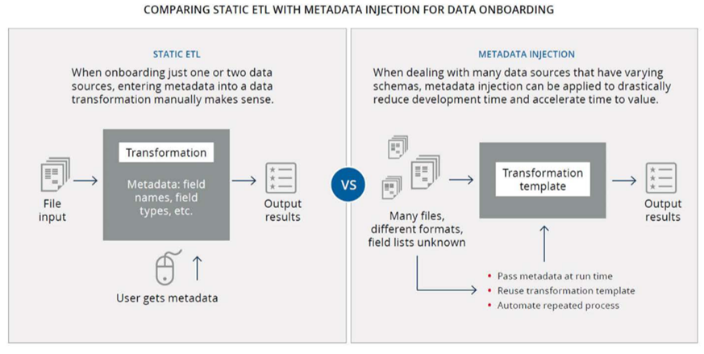
Metadata Injection: concept

Slide 12
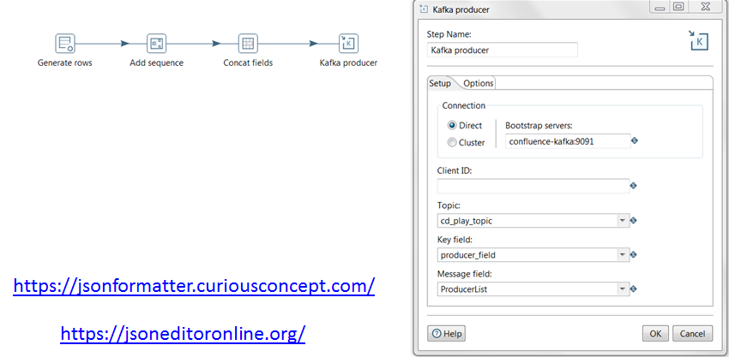
Realtime Streaming with PDI: KAFKA

Slide 13
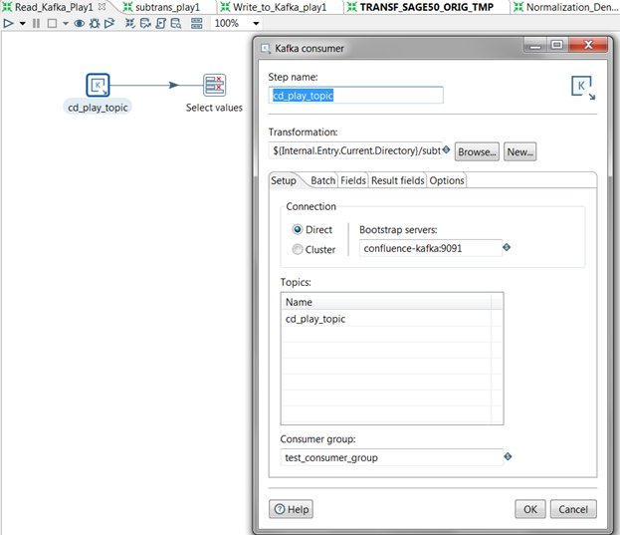
Realtime Streaming with PDI: KAFKA

Slide 14
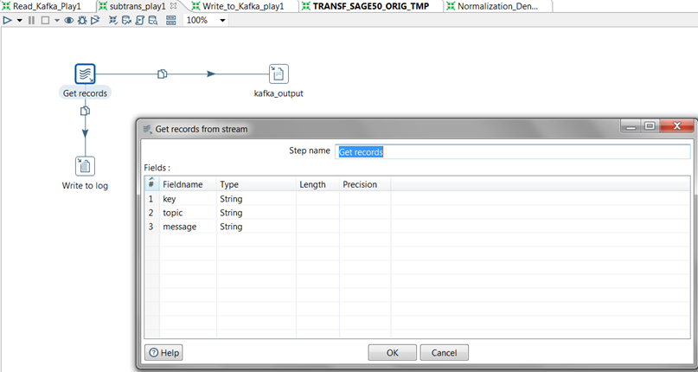
Realtime Streaming with PDI: KAFKA

Slide 15
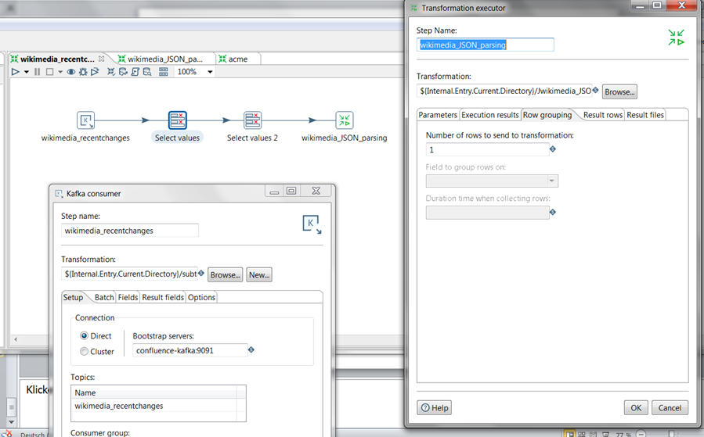
Realtime Streaming with PDI: KAFKA

Slide 16
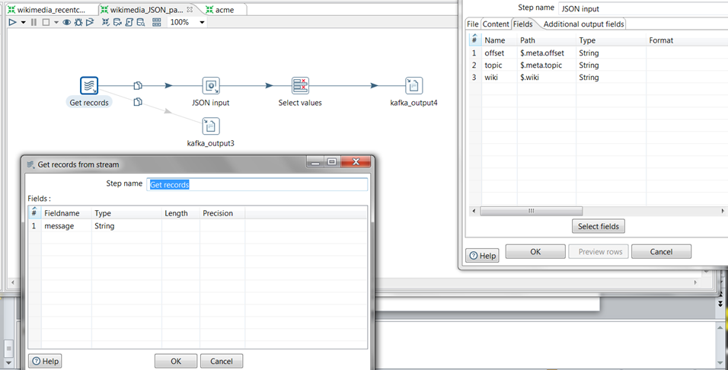
Realtime Streaming with PDI: KAFKA

Slide 17
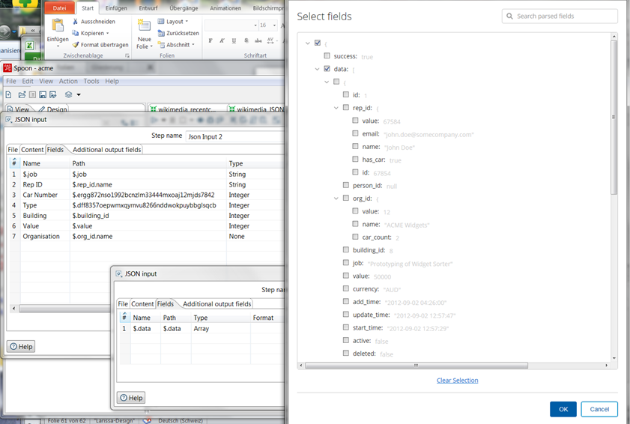
Realtime Streaming with PDI: KAFKA

